Slide 1

Big Mountain Resort Ticket Price Analysis
Market Segment Analysis and Recommendation

Slide 2
Problem Identification
Context:
Big Mountain Resort: 105 trails and 350,000 visitors/yr
Recently installed additional chairlift ($1,540,000 cost)
Pricing strategy: charge a premium above the average price of resorts in its market segment
Criteria for Success:
Cost for new chair lift covered by reducing expenses or increasing revenue through pricing
Scope of Solution Space:
Cut costs without undermining ticket price
Support raising ticket price higher
Constraints:
330 resorts across the US, which apply most directly?
26 different variables to consider
Cost of chairlift is $1,540,000
Key Stakeholders:
Jimmy Blackburn: Director of Operations
Alesha Eisen: Database Manager
Key Data Sources:
CSV file of market competition from database manager
27 columns of data, both numerical and categorical

Slide 3
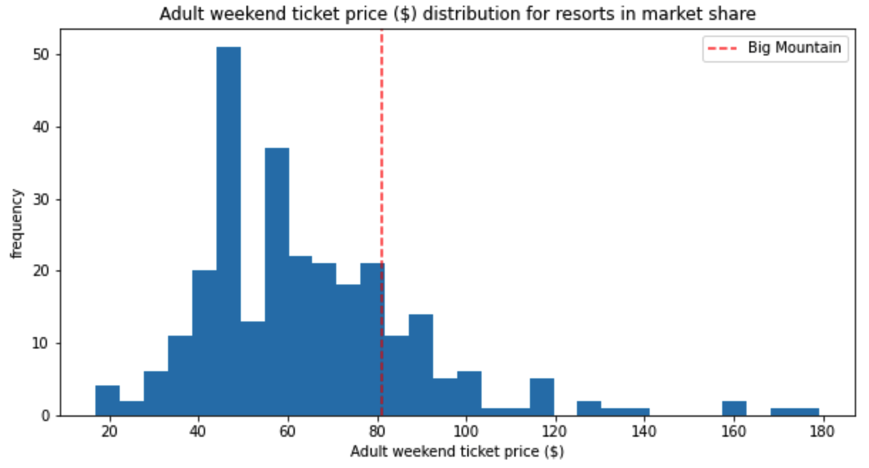
Problem Identification
Problem ID Statement:
“What opportunities exist for Big Mountain Resort to offset the additional cost of the new chair lift by reducing operational expenditures or increasing revenue through pricing strategy before the start of the next winter season.”

Slide 4
Recommendation
Recommendation:
Modeling Scenario 2 supports higher ticket price: adding run, increasing vertical drop, and adding a new chairlift
Increasing ticket price $1.99 will result in $3,474,638 of additional revenue
Revenue increase enough to cover additional operating expense from chairlift ($1,540,000)
Other opportunities exist to cut costs during maintenance (# of runs open)
Big Mountain Current Price
Big Mountain Proposed Price Increase

Slide 5
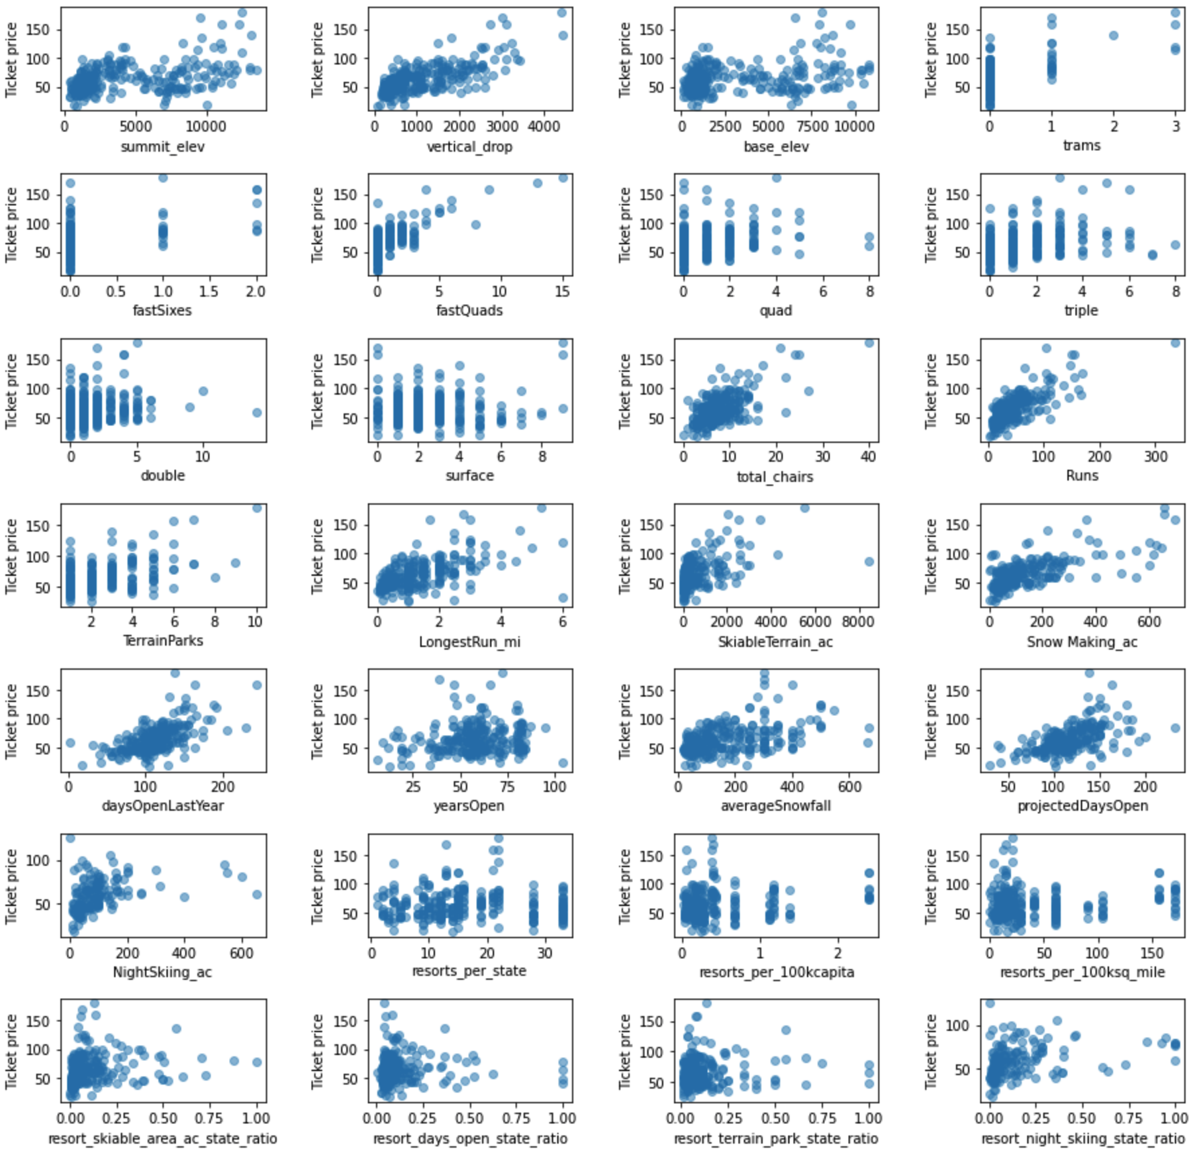
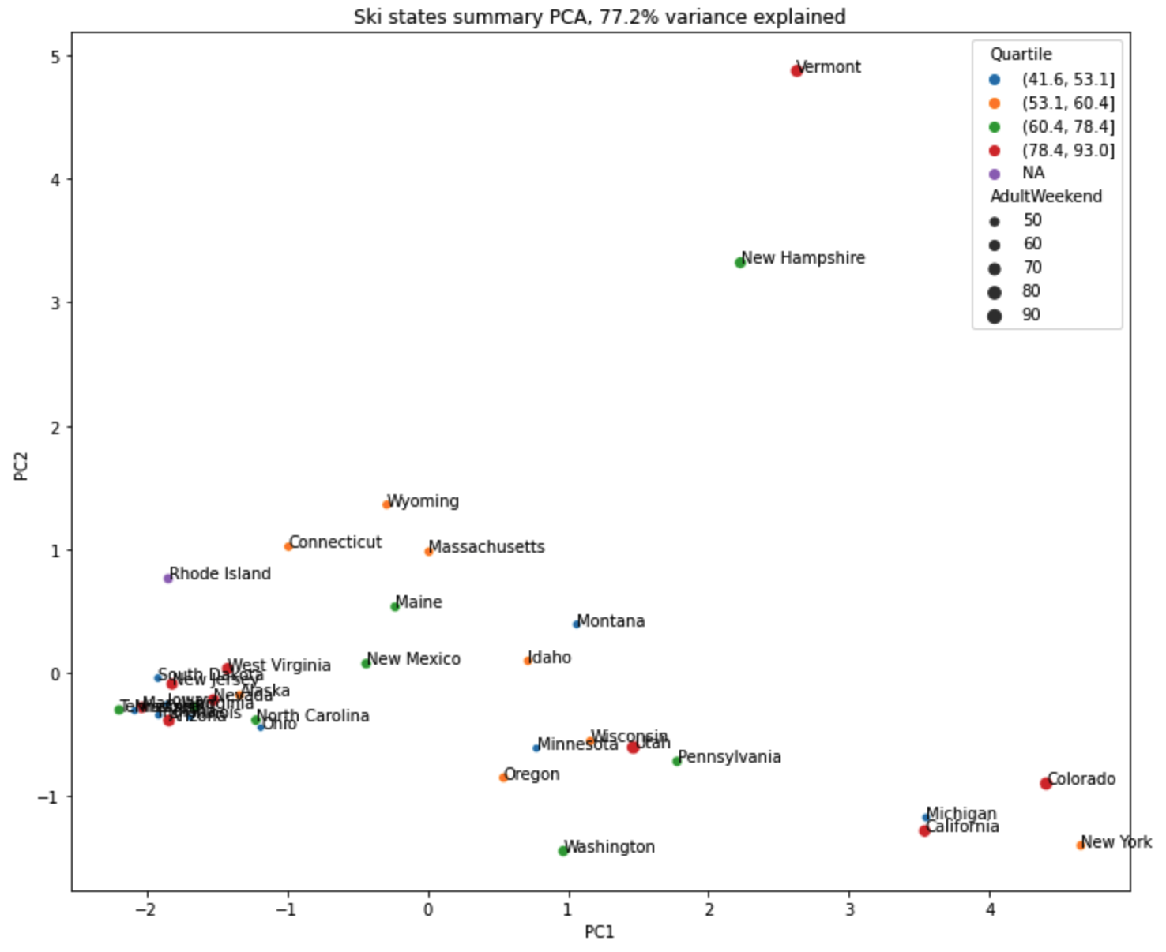
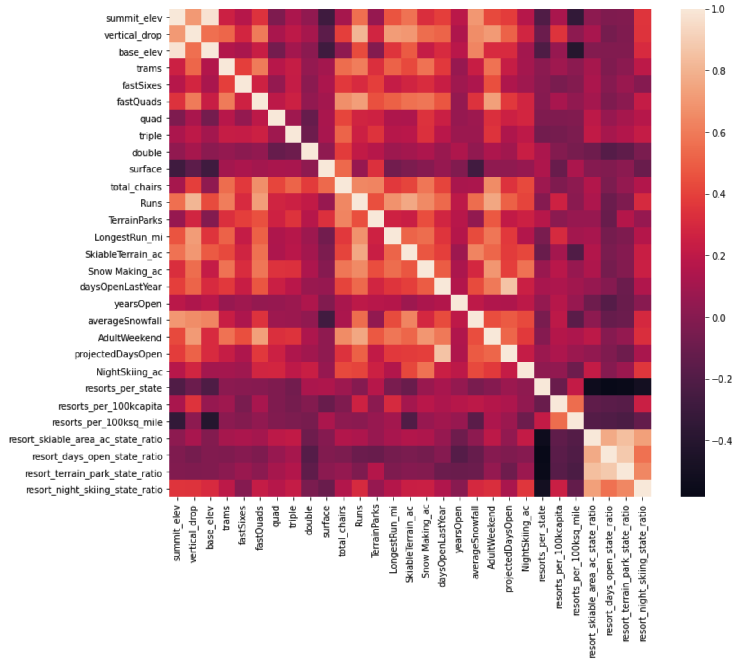
Data Wrangling & EDA
Removed rows with null values for ticket prices, 277 rows
Evaluated data for state/regional trends (PCA), decided to treat all states equally
Feature correlation using heatmap and scatter plots
Four key features with apparent linear relationship to price: vertical_drop, fastQuads, Runs, and total_chairs
Ticket Price vs Feature Correlation Scatter Plots
PC1 vs PC 2 Quartile Scatter Plot
Feature Correlation Heatmap

Slide 6
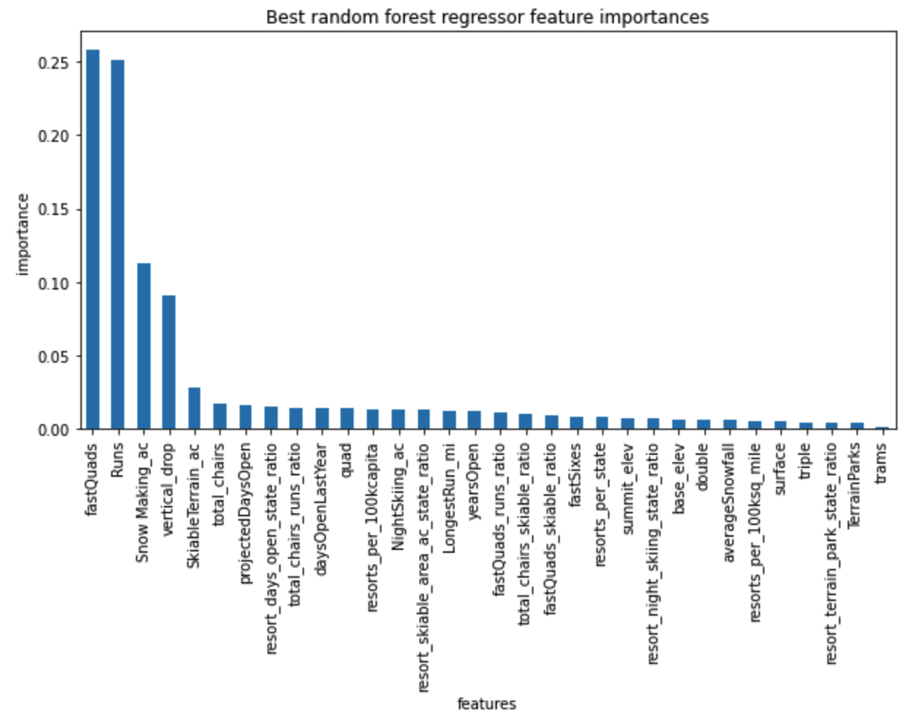
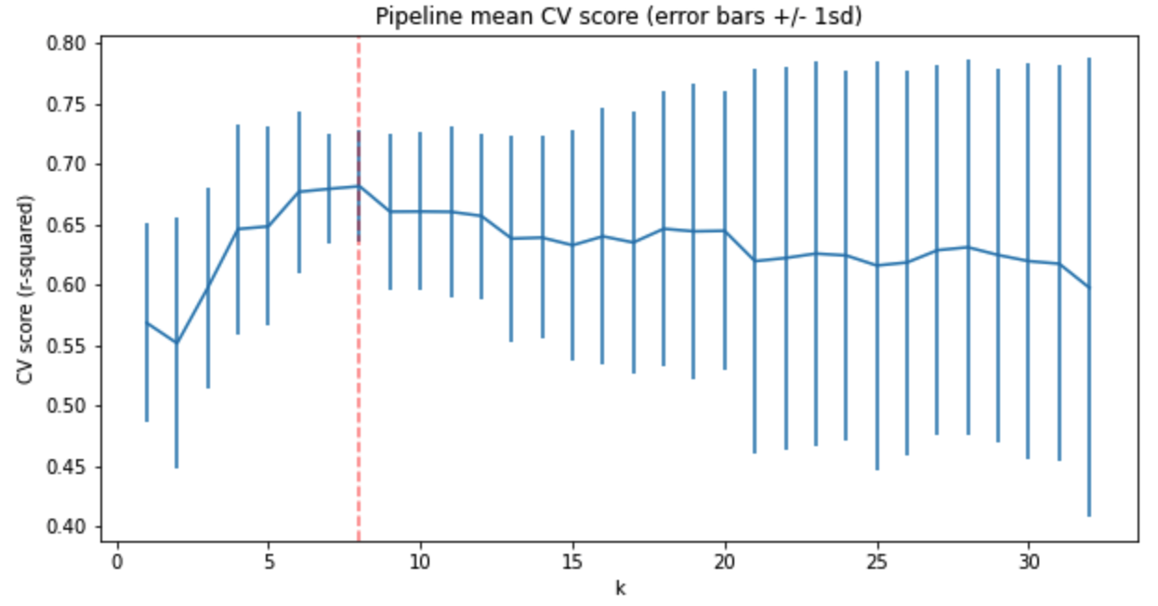
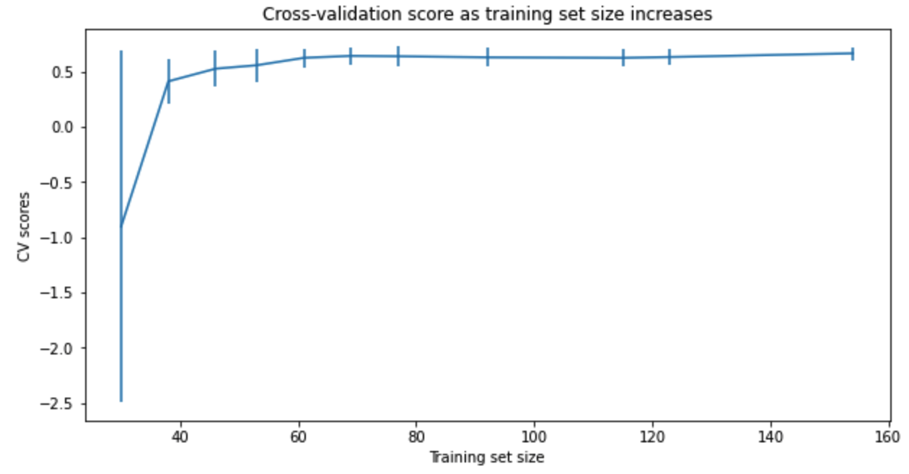
Pre-Processing & Training
Separated dataset into test/train splits (70/30)
Using mean ticket price of the dataset: $63.81 (MAE = ~$19)
Linear Regression model, imputed values using mean and median, no difference, better than using mean (MAE = ~$9)
Refined linear model using GridsearchCV to use only the best features in the model (selectkbest) and limit over-fitting
Random Forest regression model resulted in best performance of the models tested, with lower CV MAE by ~$1 and less variability
Identified 4 key features for modeling from RF model
CV score vs training set size suggests we have enough data

Slide 7
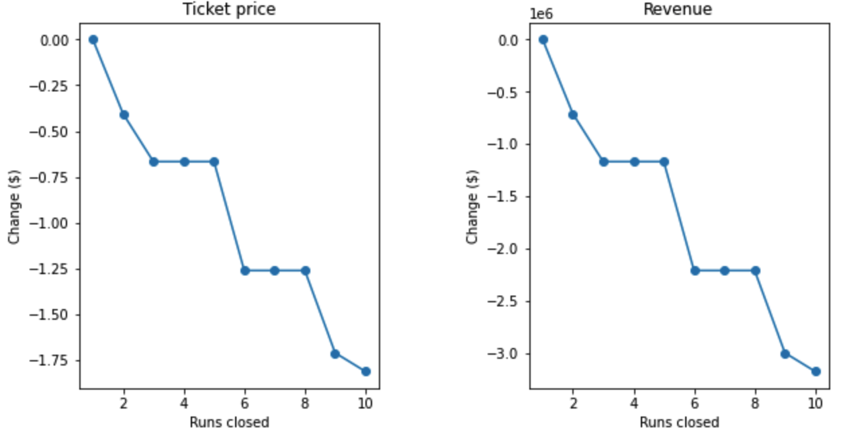
Scenario Modeling
Scenarios run using RF regression model, approx. 350,000 visitors
Scenario 1: Close zero to 10 of least used runs
Negative impact on ticket price support, increases significantly above 5 runs closed, no change from 3-5 runs closed
Scenario 2: Add a run, increase vertical drop 150ft, add a chairlift
Positive impact on ticket price, supports raising ticket price $1.99
Additional revenue from ticket price increase = $3,474,638
Scenario 3: Scenario 2, plus adding 2 acres of snow-making area
No change from Scenario 2
Scenario 4: Scenario 2, plus increasing longest run 0.2 and adding 4 acres of snow-making area
No change from Scenario 2

Slide 8
Summary
Problem identified:
Covering operating cost of new chairlift
Data Wrangling:
Removed null value price rows, fixed/removed outliers
Exploratory Data Analysis:
Identified variables with linear relationship to ticket price
Pre-Processing and Training:
Separated train/test sets
Created linear regression models and optimized parameters
Random Forest model had best fit, lowest MAE.
Modeling:
Multiple scenarios run using RF model to test variable sensitivities
Conclusions:
Increasing ticket price $1.99 will result in $3,474,638 of additional revenue and cover new chairlift operating costs

